Slide 1
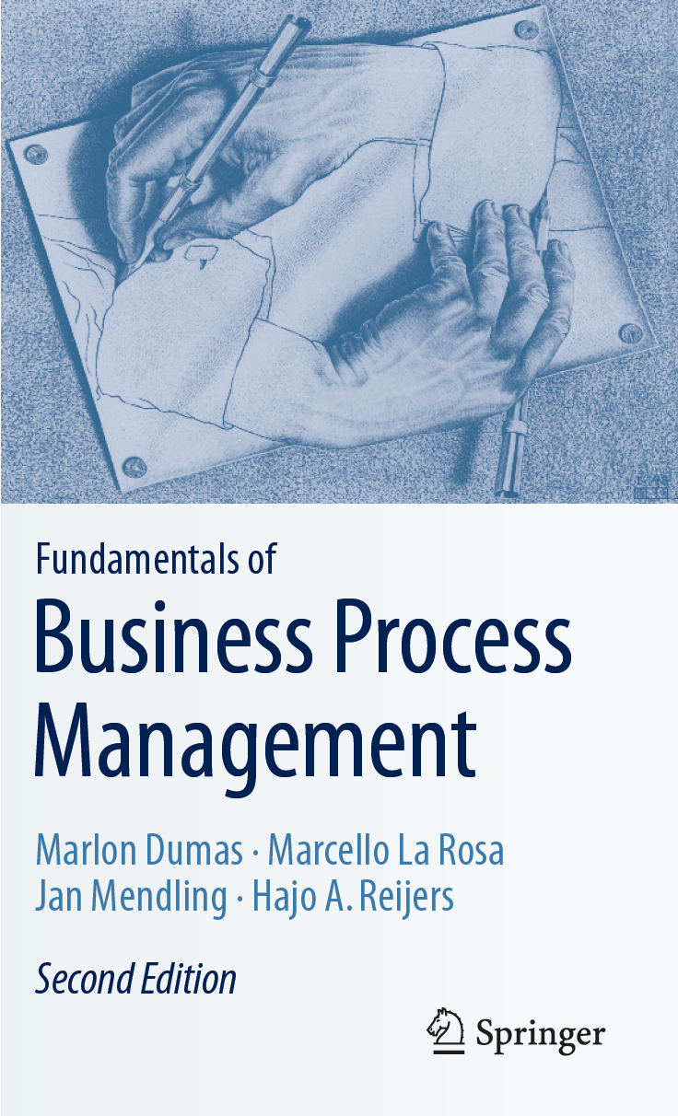
Chapter 3: Essential Process Modeling
Contents
First Steps with BPMN
Branching and Merging
Business Objects
Resources
Process Decomposition
Process Model Reuse
Recap

Slide 2

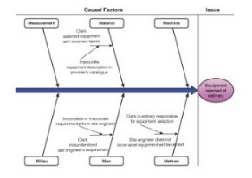
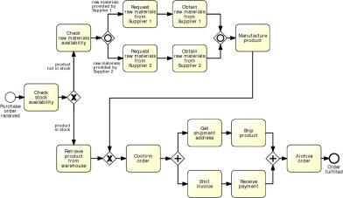
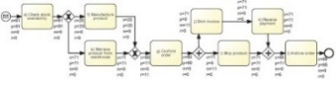
Process Modeling in the BPM Lifecycle

Slide 3
Chapter 3: Essential Process Modeling
Contents
First Steps with BPMN
Branching and Merging
Business Objects
Resources
Process Decomposition
Process Model Reuse
Recap

Slide 4

Business Process Model and Notation (BPMN)
OMG standard (BPMN 2.1)
Supported by numerous tools: bpmn.org lists over 70 tools
Both for conceptual and executable models

Slide 5
BPMN from 10,000 miles…
Based on popular graphical flowcharts:
Core set of notation elements
Each core element has various subtypes
A BPMN process model is a graph consisting of four types of core elements:
start
end
activity
event
gateway
sequence flow

Slide 6
Let’s start modeling
Order-to-cash
A typical order-to-cash process is triggered by the receipt of a purchase order from a customer. The purchase order has to be checked against the stock regarding the availability of the item(s) requested. Depending on stock availability the purchase order may be confirmed or rejected.
If the purchase order is confirmed, an invoice is emitted and the goods requested are shipped. The process completes by archiving the order or if the order is rejected.

Slide 7
Solution in BPMN: Order-to-cash
end event
activity
split gateway
end event
start event
Naming conventions
Event: noun + past-participle verb (e.g. insurance claim lodged)
Activity: imperative verb + noun (e.g. assess credit risk)

Slide 8
BPMN core elements
Activities capture work performed in a process
Different types of activities
Events represent the process’ triggers (start event) and outcomes (end event).
Different types of events
activity
start
event
end
event

Slide 9
BPMN core elements
Gateways capture forking and joining paths in the control flow.
Different types of gateways
Sequence flows represent the order in which activities and events will be performed.
They can be assigned a condition to distinguish between alternative branches.
Different types of flows
gateway
sequence flow

Slide 10
Process model vs process instances: The tokens game
Order #1
Order #2
Order #3

Slide 11
A little bit more on events…
A start event triggers a new process instance by generating a token that traverses the sequence flow (“tokens source”)
An end event signals that a process instance has
completed with a given outcome by consuming
a token (“tokens sink”)
start
event
end
event

Slide 12
Let’s reconsider our order-to-cash example
[…] If the purchase order is confirmed, an invoice is emitted and the goods requested are shipped. The process completes by archiving the order. […]

Slide 13

Solution: Order-to-cash
Anything wrong with this model?
split
split
join

Slide 14

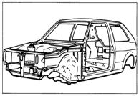

Mapping, Abstraction, and Purpose of a Model
Models are abstractions from real world phenomena, developed for the purpose of reducing overall complexity.
Models aggregate information and document only relevant aspects of the real world
Models are being developed:
in a specific modelling subject
for a specific target audience
with a specific modelling purpose in mind

Slide 15

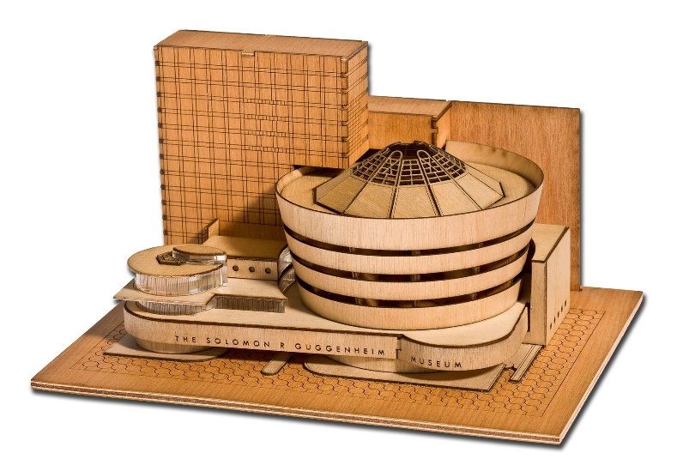
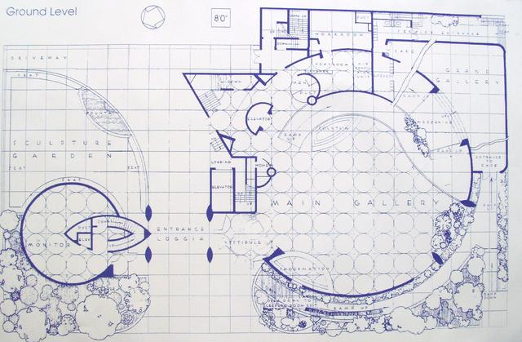
What’s the relevant model?
?

Slide 16
Chapter 3: Essential Process Modeling
Contents
First Steps with BPMN
Branching and Merging
Business Objects
Resources
Process Decomposition
Process Model Reuse
Recap

Slide 17
A little more on gateways: XOR Gateway
An XOR Gateway captures decision points (XOR-split) and points where alternative flows are merged (XOR-join)
XOR-split ➔ takes one outgoing branch
XOR-join ➔ proceeds when one incoming branch has completed

Slide 18
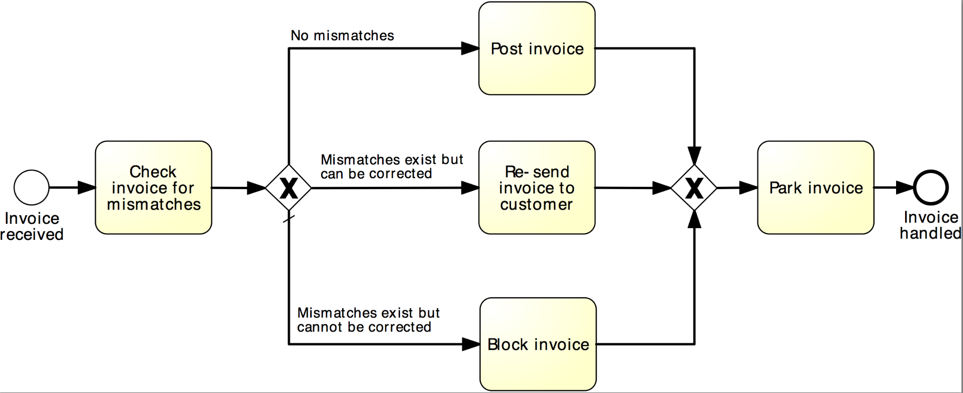
Example: XOR Gateway
Invoice checking process

Slide 19
Exercise 3.1
Model the following fragment of a business process for assessing loan applications (loan origination process).
Once a loan application has been approved by the loan provider, an acceptance pack is prepared and sent to the customer. The acceptance pack includes a repayment schedule which the customer needs to agree upon by sending the signed documents back to the loan provider. The latter then verifies the repayment agreement: if the applicant disagreed with the repayment schedule, the loan provider cancels the application; if the applicant agreed, the loan provider approves the application. In either case, the process completes with the loan provider notifying the applicant of the application status.

Slide 20
A little more on gateways: AND Gateway
An AND Gateway provides a mechanism to create and synchronize “parallel” flows.
AND-split ➔ takes all outgoing branches
AND-join ➔ proceeds when all incoming branches have completed

Slide 21
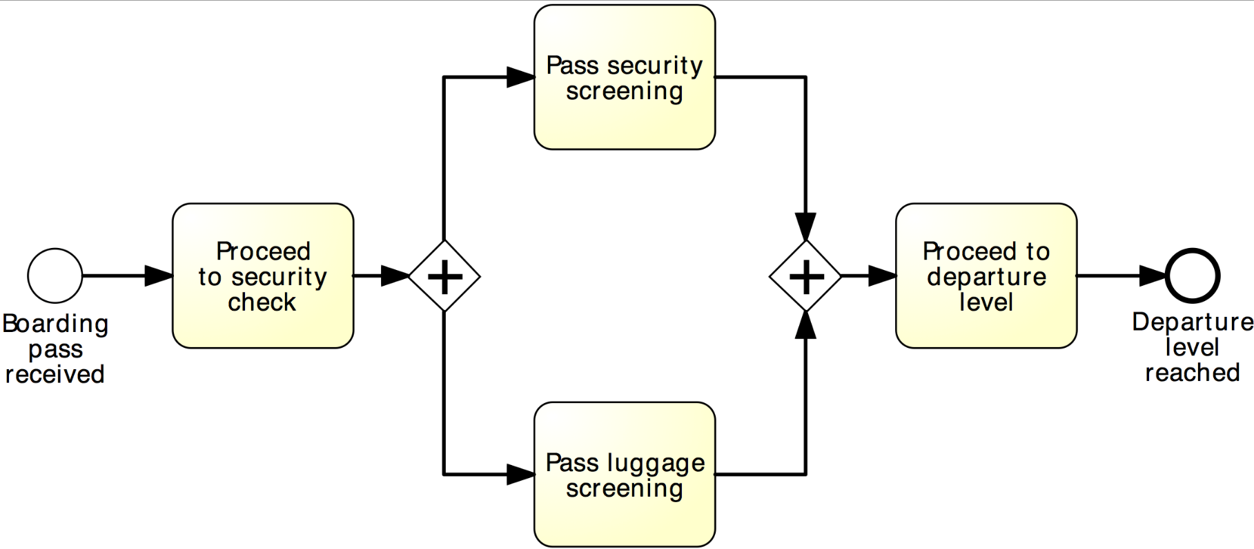
Example: AND Gateway
Airport security check

Slide 22
Revised solution
Order-to-cash
XOR-split
AND-split
AND-join

Slide 23
Exercise 3.2
Model the following fragment of a business process for assessing loan applications.
A loan application is approved if it passes two checks: i) the applicant’s loan risk assessment, done automatically by a system, and ii) the appraisal of the property for which the loan has been asked, carried out by a property appraiser. The risk assessment requires a credit history check on the applicant, which is performed by a financial officer. Once both the loan risk assessment and the property appraisal have been performed, a loan officer can assess the applicant’s eligibility. If the applicant is not eligible, the application is rejected, otherwise the acceptance pack is prepared and sent to the applicant.

Slide 24
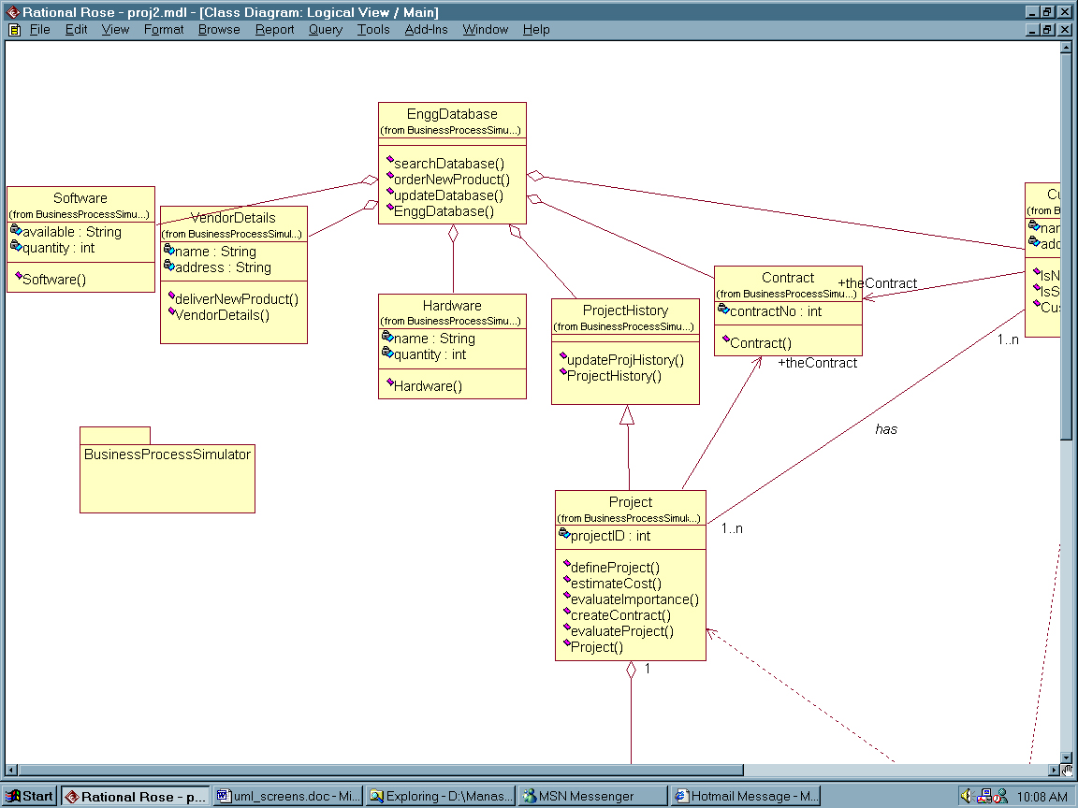
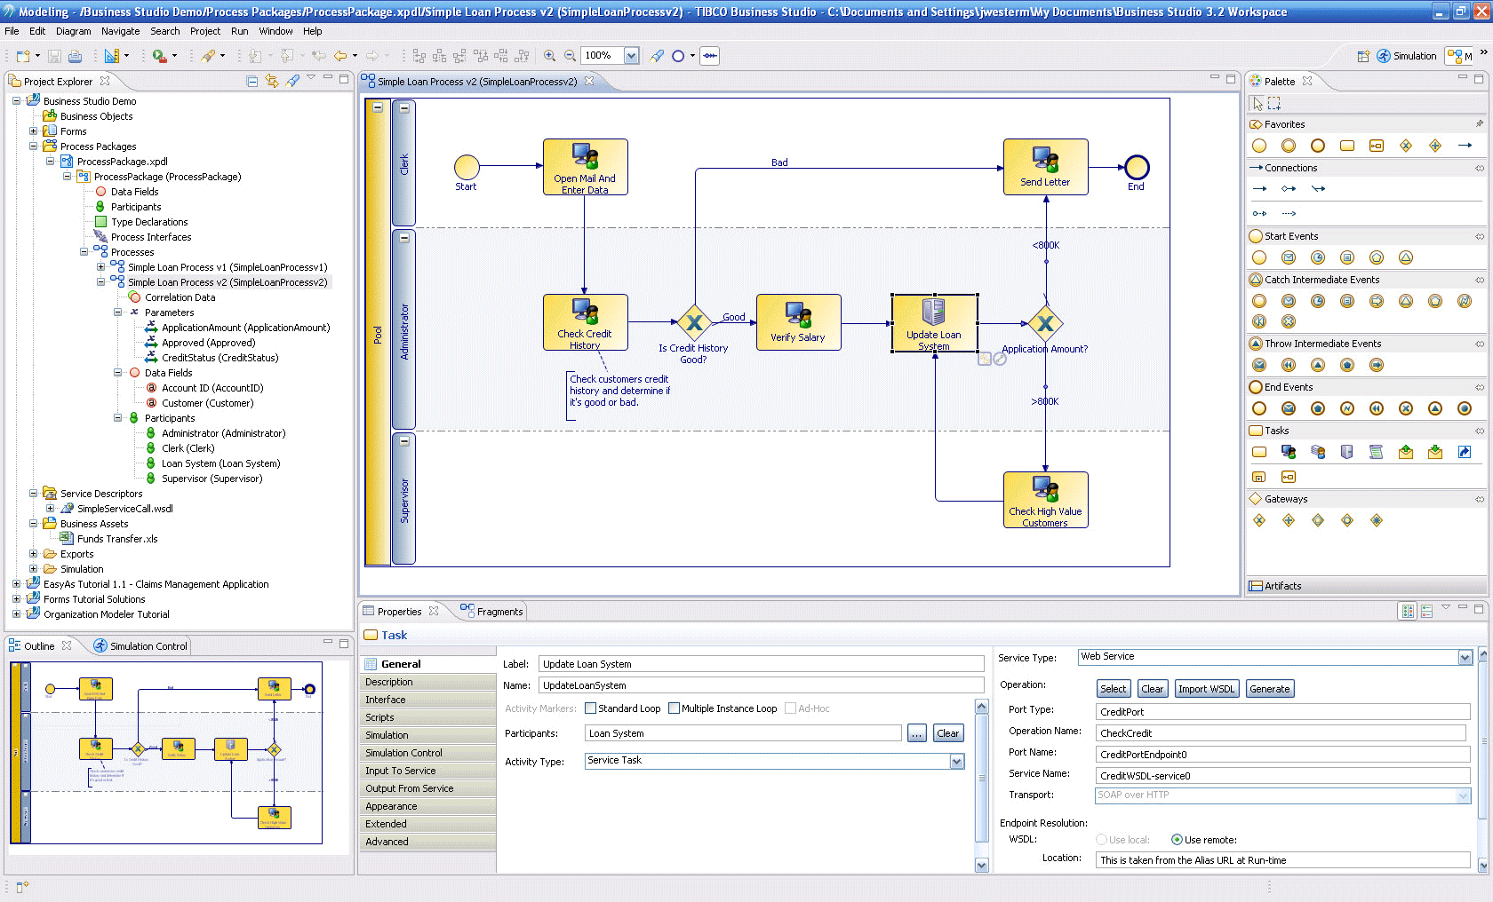
Business Process Modeling Tools
Pen & Paper
Haptic
Standalone
E.g. Visio, Camunda Modeler
Repository-based
E.g. ARIS, Signavio, Apromore

Slide 25
XOR / AND are not always what we need...
Order distribution process
A company has two warehouses, one in Amsterdam, the other in Hamburg, that store different products. When an order is received, it is distributed across these warehouses: if some of the relevant products are maintained in Amsterdam, a sub-order is sent there; likewise, if some relevant products are maintained in Hamburg, a sub-order is sent there. Afterwards, the order is registered and the process completes.

Slide 26
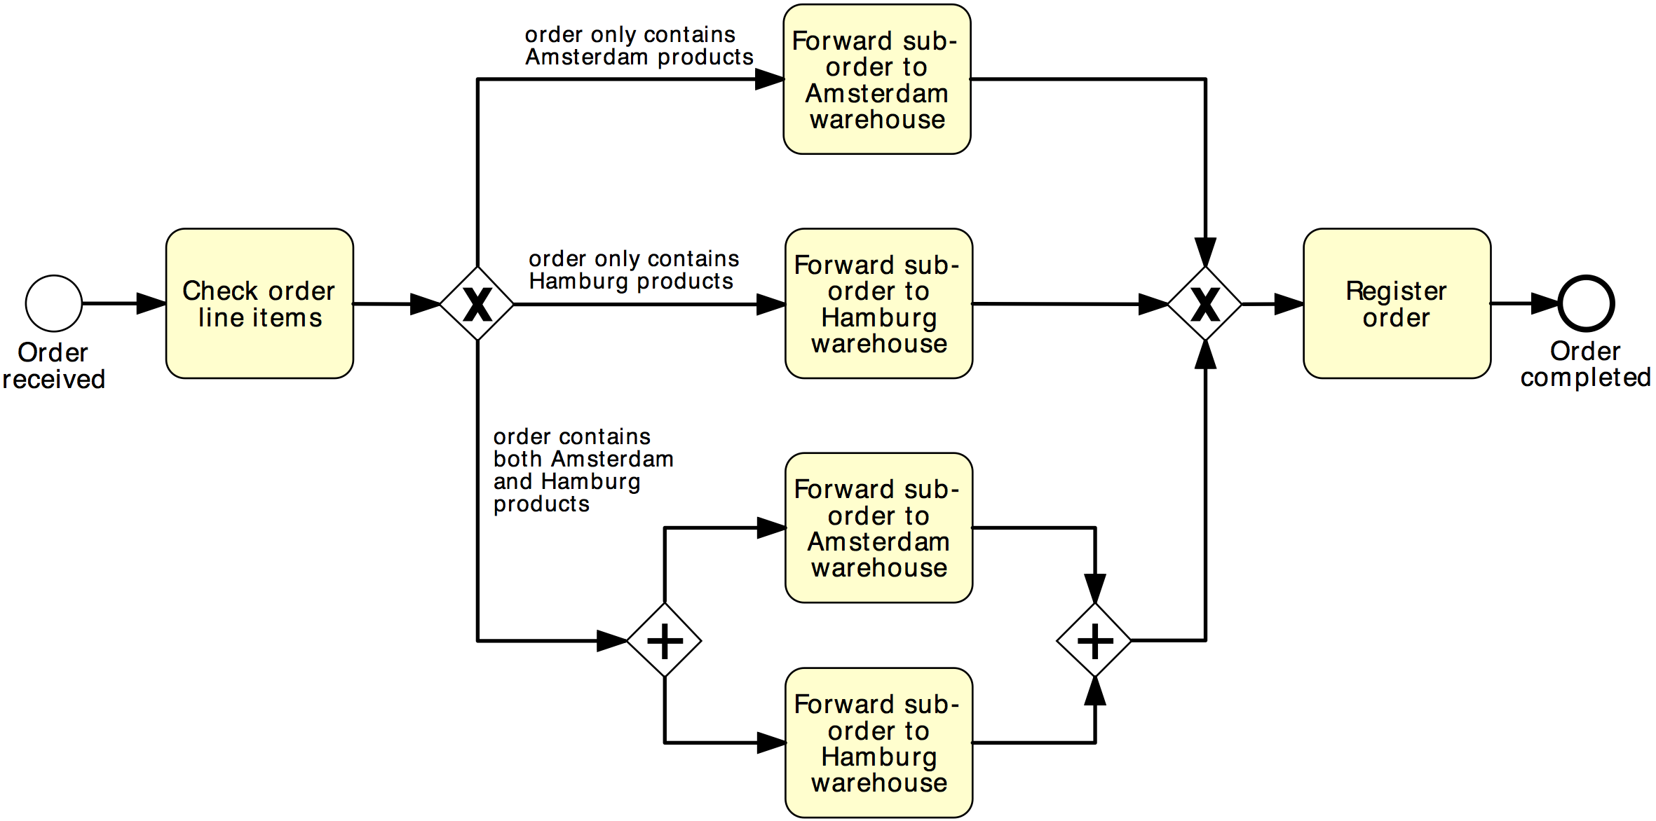
Solution 1
Order distribution process
XOR-split
XOR-join
AND-split
AND-join

Slide 27
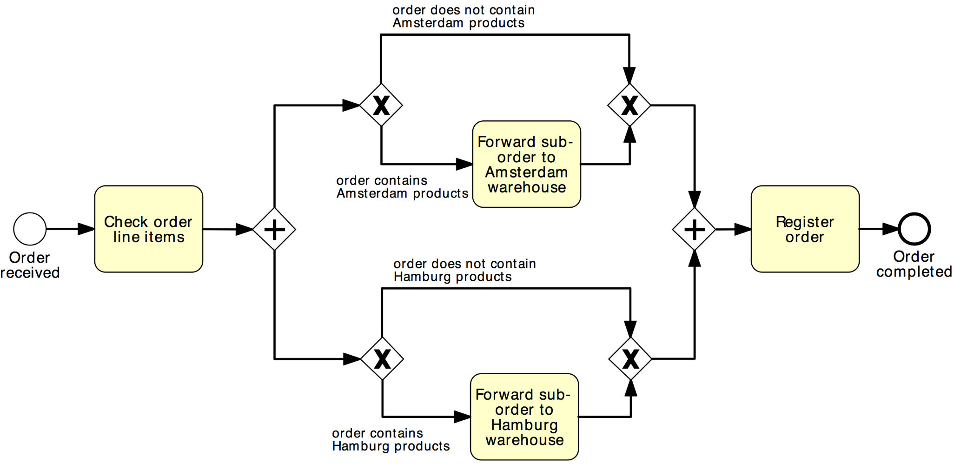
Solution 2
Order distribution process
AND-split
AND-join
XOR-split
XOR-join

Slide 28
OR Gateway
An OR Gateway provides a mechanism to create and synchronize n out of m parallel flows.
OR-split ➔ takes one or more branches depending on conditions
OR-join ➔ proceeds when all active incoming branches have completed

Slide 29
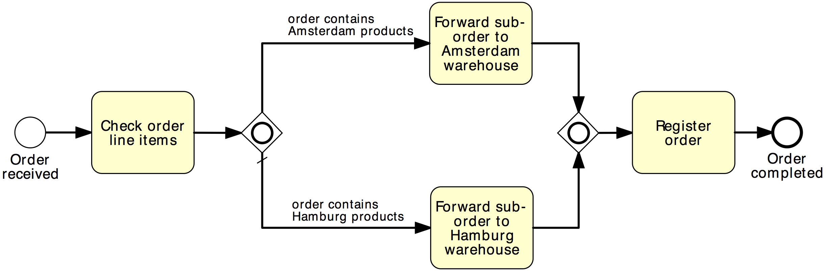
Solution using OR Gateway
Order distribution process
OR-split
OR-join

Slide 30
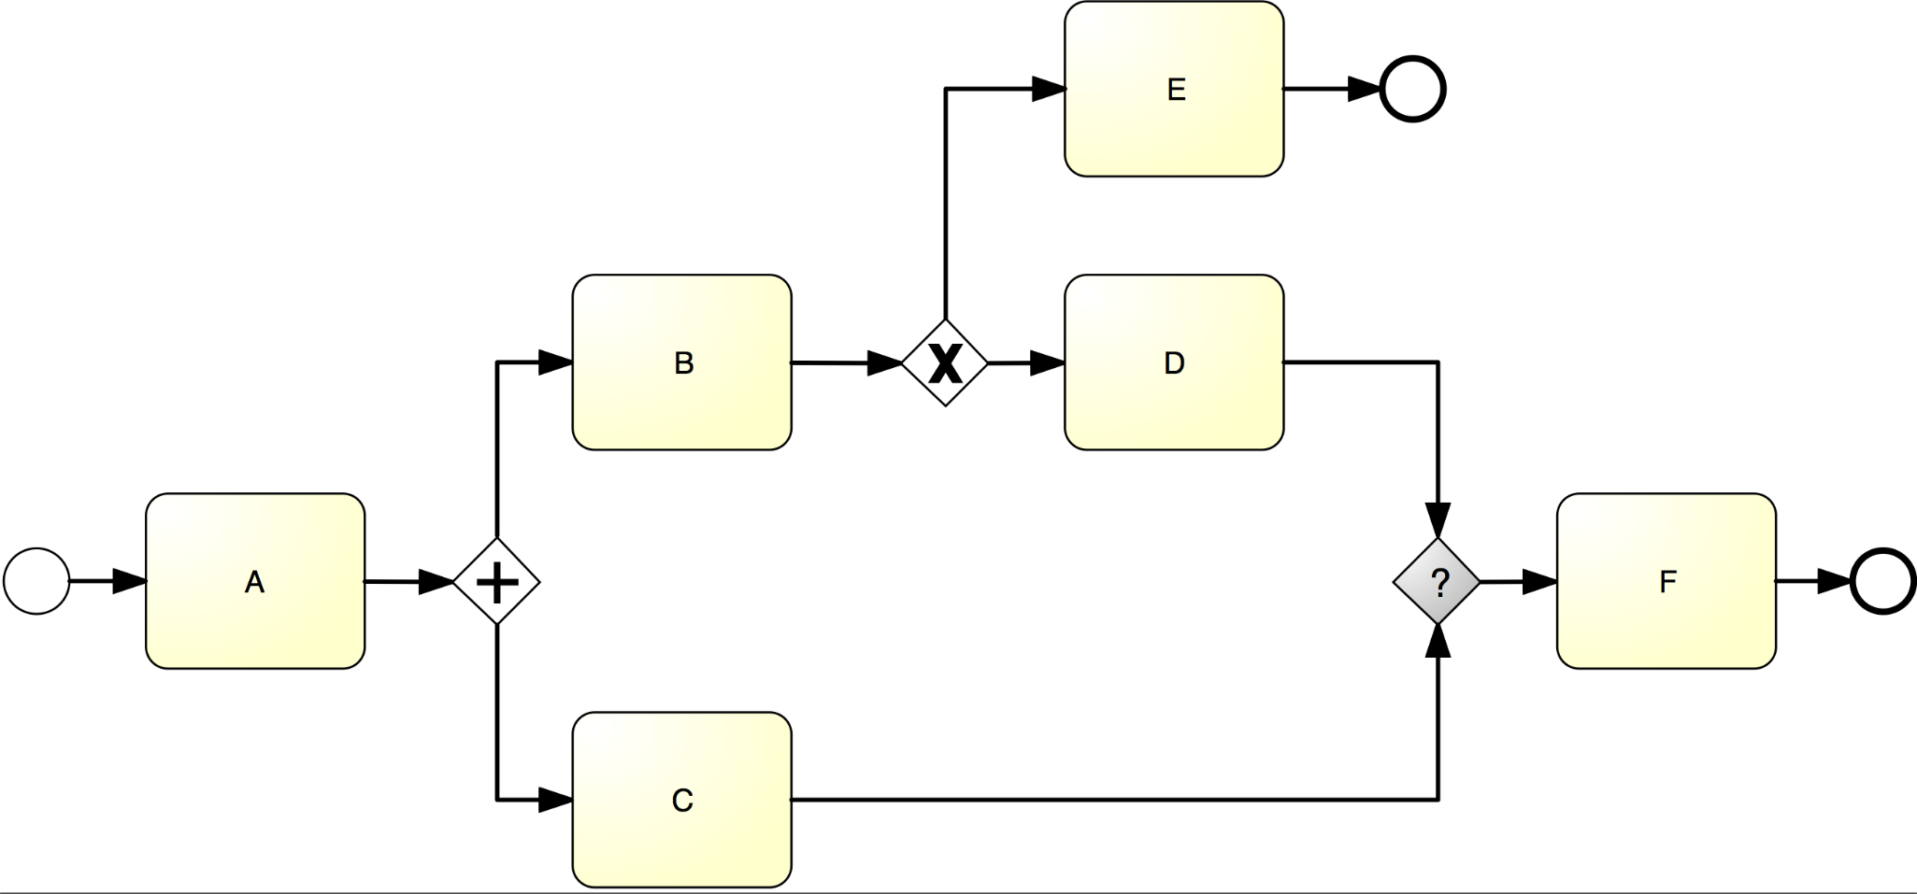
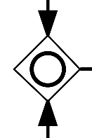
What join type do we need here?

Slide 31

When should we use an OR-join?

Slide 32
Exercise 3.3
Model the following fragment of a business process for assessing loan applications.
A loan application may be coupled with a home insurance which is offered at discounted prices. The applicants may express their interest in a home insurance plan at the time of submitting their loan application to the loan provider. Based on this information, if the loan application is approved, the loan provider may either only send an acceptance pack to the applicant, or also send a home insurance quote. The process then continues with the verification of the repayment agreement.

Slide 33
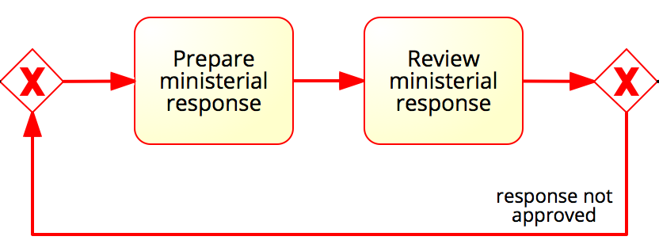
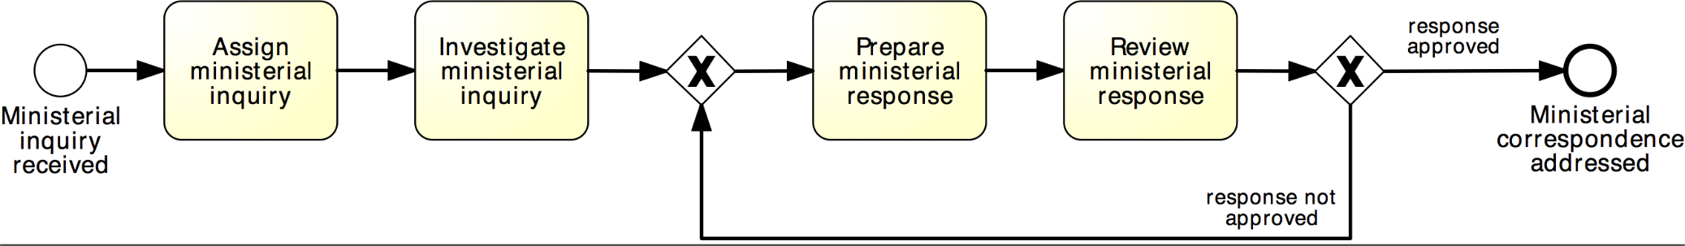
Rework and repetition
Address ministerial correspondence
In the treasury minister’s office, once a ministerial inquiry has been received, it is registered into the system. Then the inquiry is investigated so that a ministerial response can be prepared.
The finalization of a response includes the preparation of the response itself by the cabinet officer and the review of the response by the principal registrar. If the registrar does not approve the response, the latter needs to be prepared again by the cabinet officer for review. The process finishes only once the response has been approved.
XOR-join: entry point
XOR-split: exit point

Slide 34
Why do we need to merge the loopback branch of a repetition block with an XOR-join?

Slide 35
Exercise 3.4
Model the following fragment of a business process for assessing loan applications.
Once a loan application is received by the loan provider, and before proceeding with its assessment, the application itself needs to be checked for completeness. If the application is incomplete, it is returned to the applicant, so that they can fill out the missing information and send it back to the loan provider. This process is repeated until the application is found complete.

Slide 36
Components of a modeling language
Modelling Language
Vocabulary
Syntax
Semantics
Notation

Slide 37
Components of a modeling language: Vocabulary
Vocabulary: set of modeling elements of the language (BPMN: activities, gateways, events…)
Modelling Language
Vocabulary
Syntax
Semantics
Notation

Slide 38
Components of a modeling language: Syntax
Syntax: set of rules to govern how these elements can be combined (BPMN: start events only have outgoing sequence flows whereas end events only have incoming sequence flows).
Modelling Language
Vocabulary
Syntax
Semantics
Notation

Slide 39
Components of a modeling language
Semantics: bind these elements, including their textual descriptions, to a precise meaning (in BPMN: activities model something actively performed during the business process, while XOR gateways model exclusive decisions and simple merging points).
Modelling Language
Vocabulary
Syntax
Semantics
Notation

Slide 40
Components of a modeling language: Notation
Modelling Language
Notation: set of graphical symbols for the visualization of the elements (in BPMN: labeled rounded boxes to depict activities and the circles with a thin border to depict start events).
Vocabulary
Syntax
Semantics
Notation

Slide 41
Chapter 3: Essential Process Modeling
Contents
First Steps with BPMN
Branching and Merging
Business Objects
Resources
Process Decomposition
Process Model Reuse
Recap

Slide 42




Business Objects (aka artifacts)
Can be:
Physical or digital information artifacts (e.g. an order on paper, an invoice on PDF)
Physical material (e.g. a box containing the ordered goods)

Slide 43
Our Order-to-cash process, again
The purchase order document serves as an input to the stock availability check against the Warehouse DB. Based on the outcome of this check, the status of the document is updated, either to “approved” or “rejected”. If the order is approved, an invoice and a shipment notice are produced. The order is then archived on the Orders DB.

Slide 44
Business Objects in BPMN
A Data Object captures an artifact required (input) or produced (output) by an activity.
Can be physical or electronic
A Data Store is a place containing data objects that must be persisted beyond the duration of a process instance.
It is used by an activity to store (as output) or retrieve (as input) data objects.

Slide 45
Solution
The purchase order document serves as an input to the stock availability check against the Warehouse DB. Based on the outcome of this check, the status of the document is updated, either to “approved” or “rejected”. If the order is approved, an invoice and a shipment notice are produced. The order is then archived on the Orders DB.

Slide 46
Do data objects affect the token flow?

Slide 47
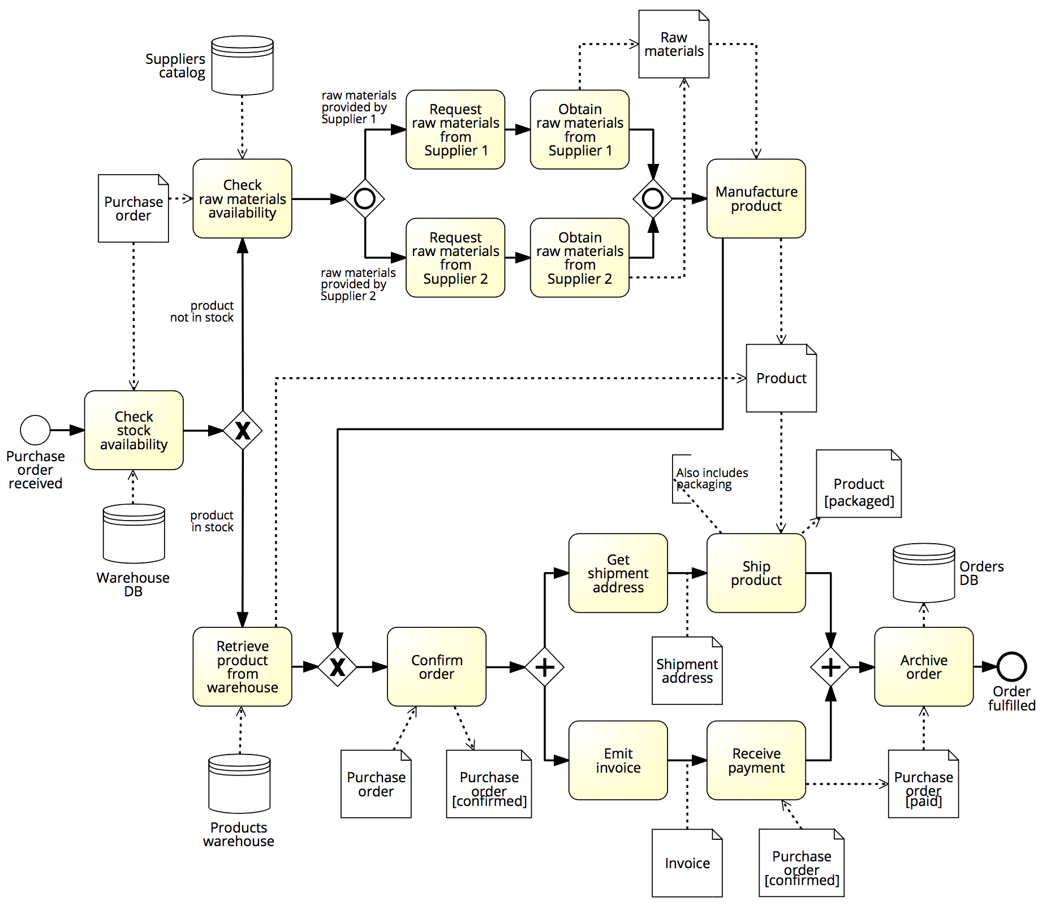
Exercise 3.5
Is there any missing data object or data store in the example below?

Slide 48
Do we always need to model data objects?

Slide 49
BPMN Text Annotations
A Text Annotation is a mechanism to provide additional text information to the model reader
Doesn’t affect the flow of tokens through the process

Slide 50
Exercise 3.6
Put together the four fragments of the loan assessment process that you created in Exercises 3.1–3.4.
Hint. Look at the labels of the start and end events to understand the order dependencies among the various fragments. Then extend the resulting model by adding all the required business objects. Moreover, attach annotations to specify the business rules behind i) checking an application completeness, ii) assessing an application eligibility, and iii) verifying a repayment agreement.

Slide 51
Chapter 3: Essential Process Modeling
Contents
First Steps with BPMN
Branching and Merging
Business Objects
Resources
Process Decomposition
Process Model Reuse
Recap

Slide 52




Resources

Slide 53

Resources
Active resources:
Process participant
Software system
Equipment
Resource class:
A group of (active) resources that are interchangeable, e.g. a role, an organizational unit or the whole organization.

Slide 54
Resources in the order-to-cash example
The order-to-cash process is carried out by a seller’s organization which includes two departments: the Sales department and the Warehouse & Distribution department.
The purchase order received by the Seller has to be checked against the stock. This is done via an ERP module within the Warehouse & Distribution department.
If the purchase order is confirmed, the Warehouse & Distribution department ships the goods. Meantime, the Sales department emits the invoice. The process concludes with the order being archived by the Sales department.

Slide 55
BPMN Elements – Pools & Lanes
Pool
Captures a resource class. Generally used to model a business party (e.g. a whole company)
Lane
Captures a resource sub-class within a resource class by partitioning a pool. Generally used to model departments (e.g. shipping, finance), internal roles (e.g. Manager, Associate), software systems (e.g. DBMS, CRM) or equipment (e.g. Manufacturing plant)

Slide 56


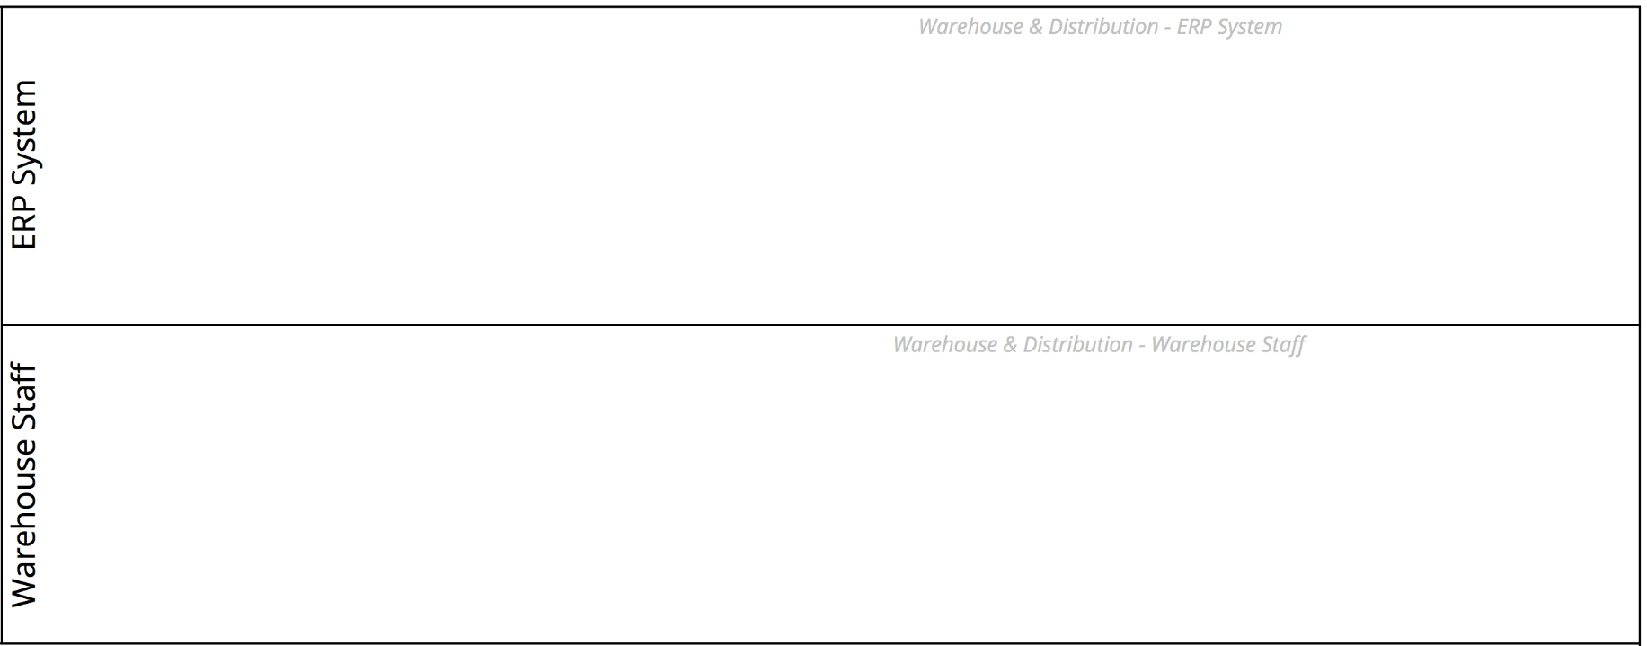
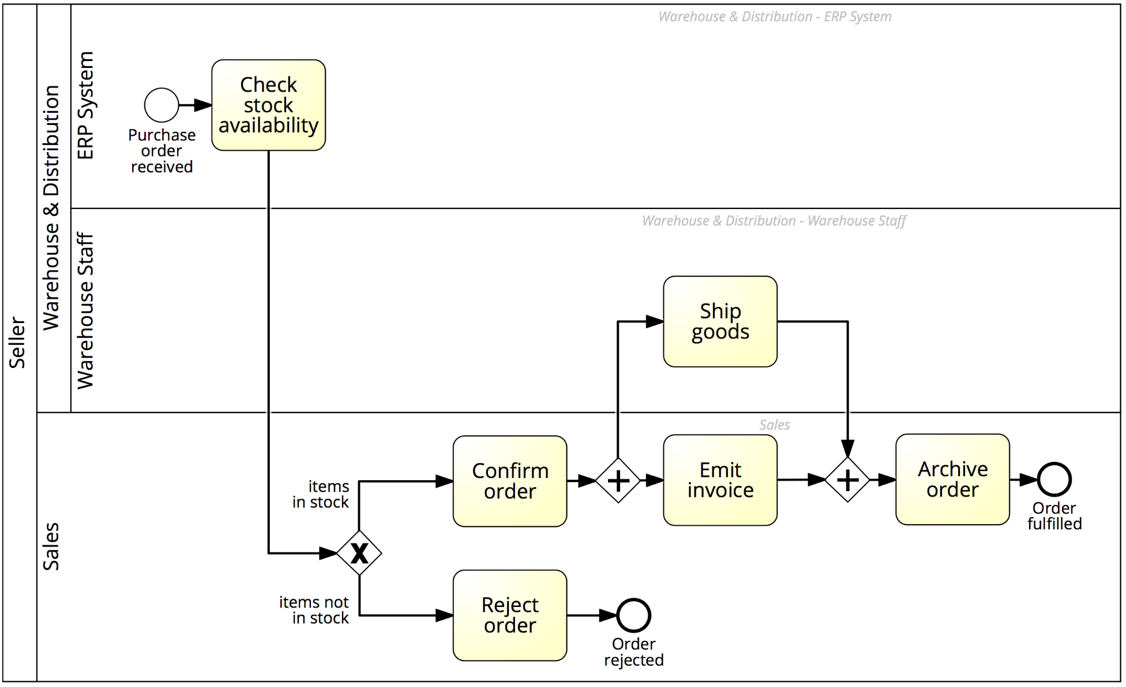
Solution: Order-to-cash

Slide 57
Exercise 3.7
Extend the business process for assessing loan applications that you created in Exercise 3.6 by considering the following resource aspects.
The process for assessing loan applications is executed by four roles within the loan provider: a financial officer takes care of checking the applicant’s credit history; a property appraiser is responsible for appraising the property; an insurance sales representative sends the home insurance quote to the applicant if this is required. All other activities are performed by the loan officer who is the main point of contact with the applicant.

Slide 58
Exchanging information between business parties
Order-to-cash
The purchase order sent by the Customer is received by the Seller and checked against the stock. This is done via an ERP module within the Warehouse & Distribution department. If the purchase order is not confirmed, the Sales department sends an order rejection to the Customer, otherwise it sends an order confirmation.
Next, the Warehouse & Distribution department ships the goods and sends a shipment notification to the Customer. Meantime, the Sales department emits the invoice and sends it to the Customer. The process concludes with the order being archived by the Sales department.

Slide 59
BPMN Elements – Message Flow
A Message Flow represents a flow of information or materials between two process parties (Pools)
A Message Flow can connect:
directly to the boundary of a Pool ➔ captures a message to/from that party
to a specific activity or event within that Pool ➔ captures a message that triggers a specific activity/event within that party

Slide 60
BPMN Elements – Start Message Event
The start message event triggers a process by the receipt of a message when an incoming message flow is connected to the event

Slide 61
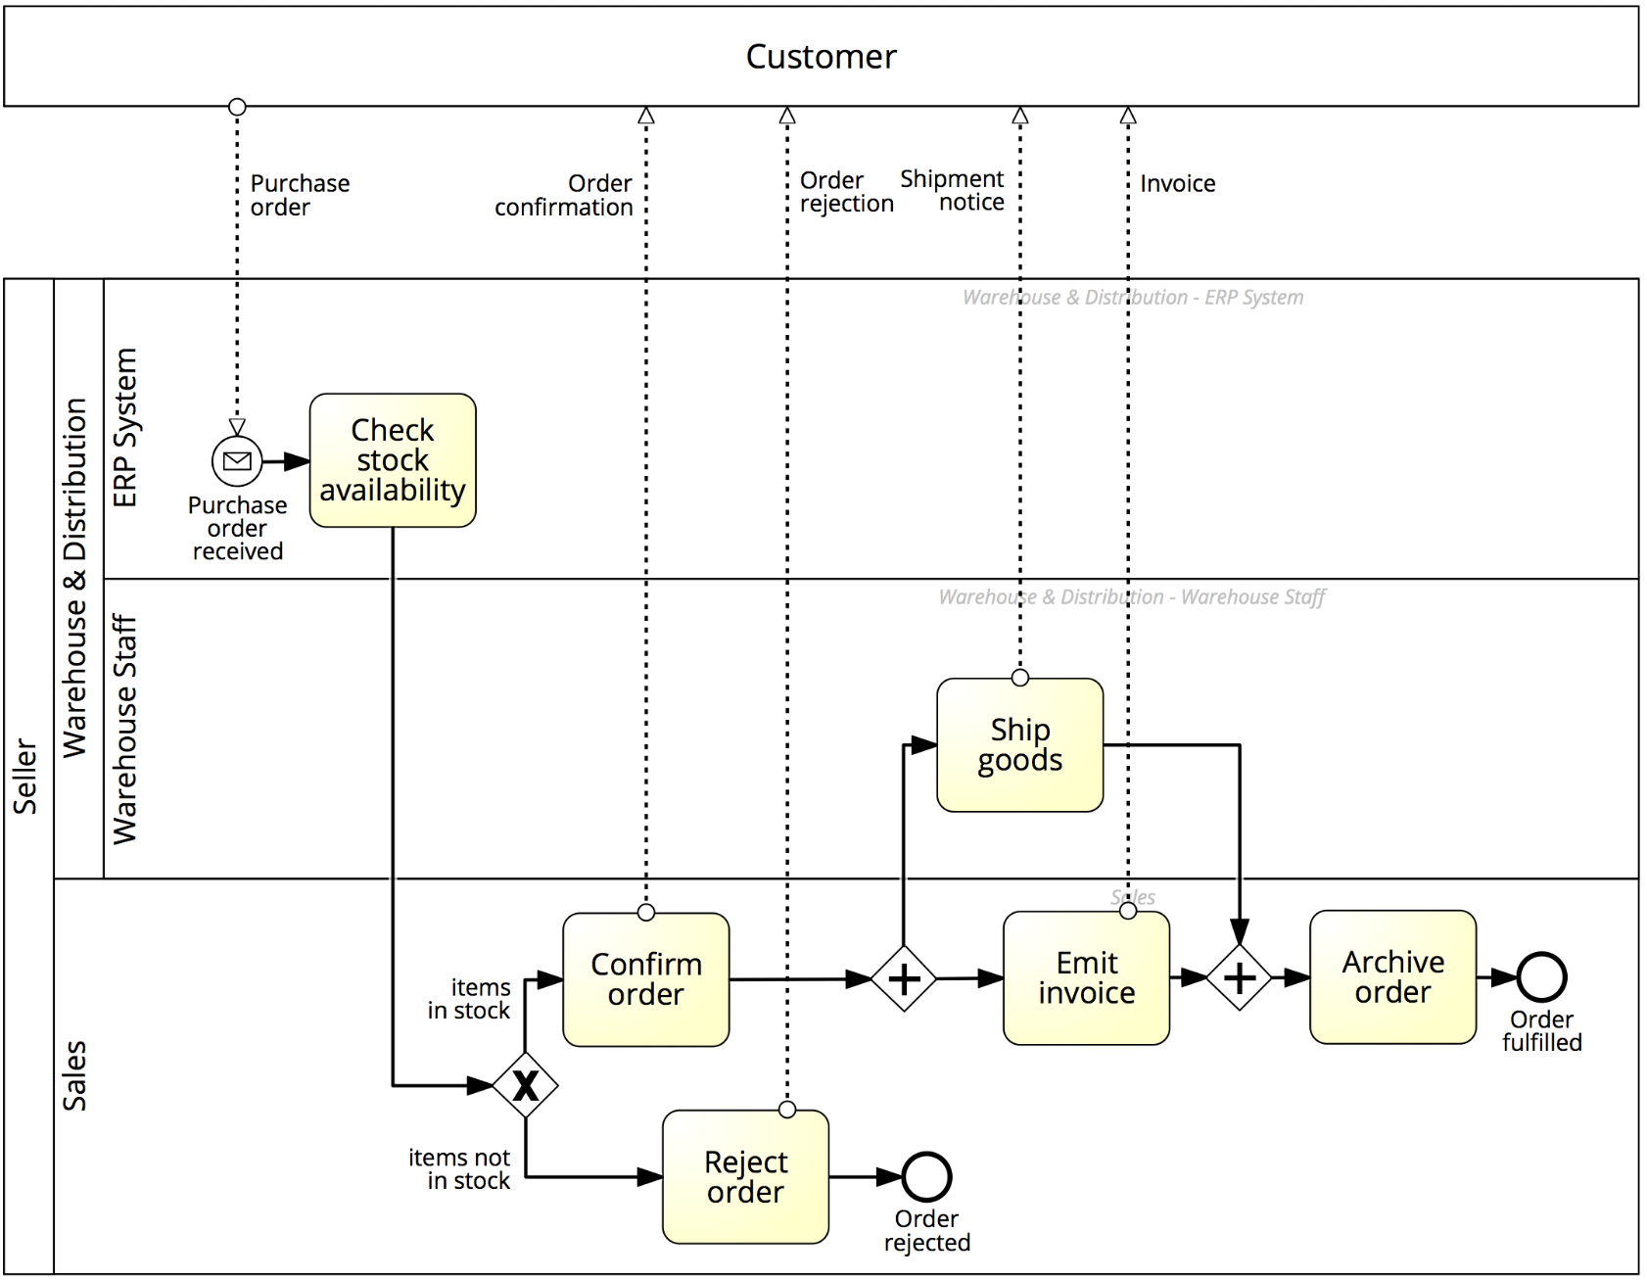

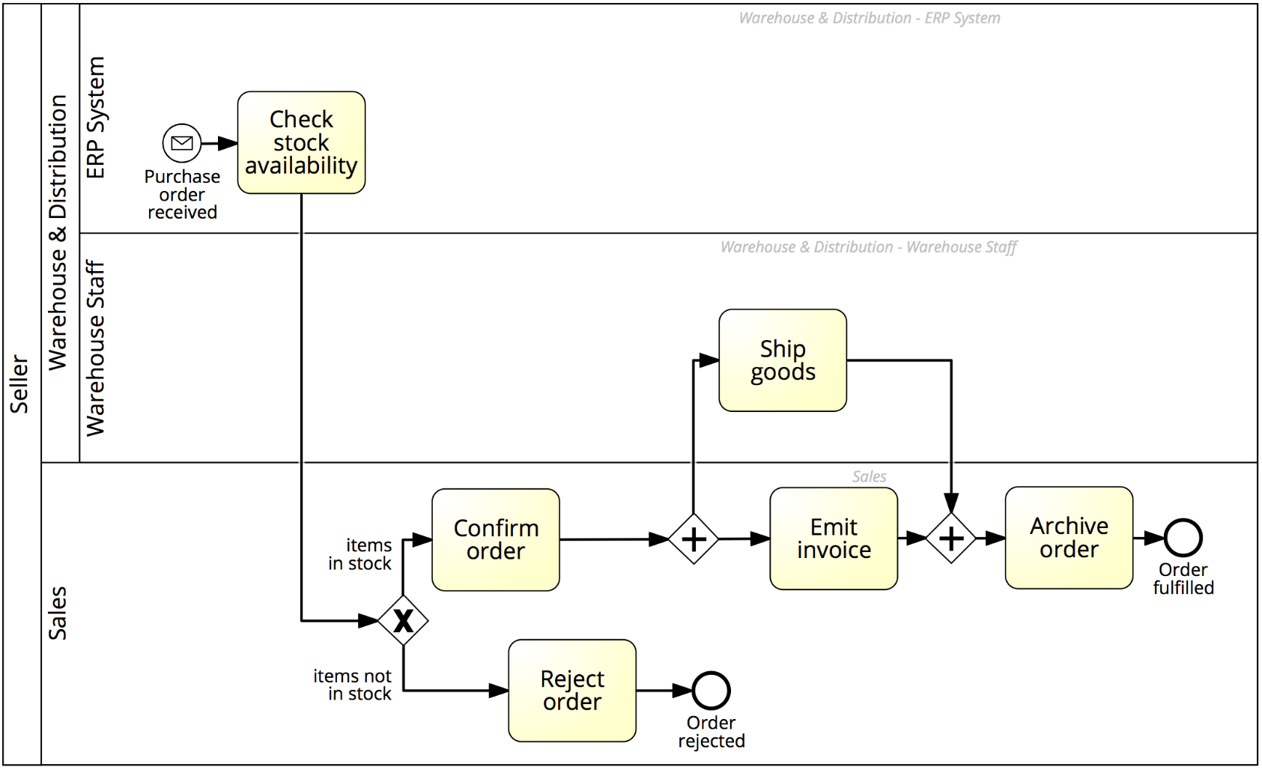
Solution: Order-to-cash

Slide 62
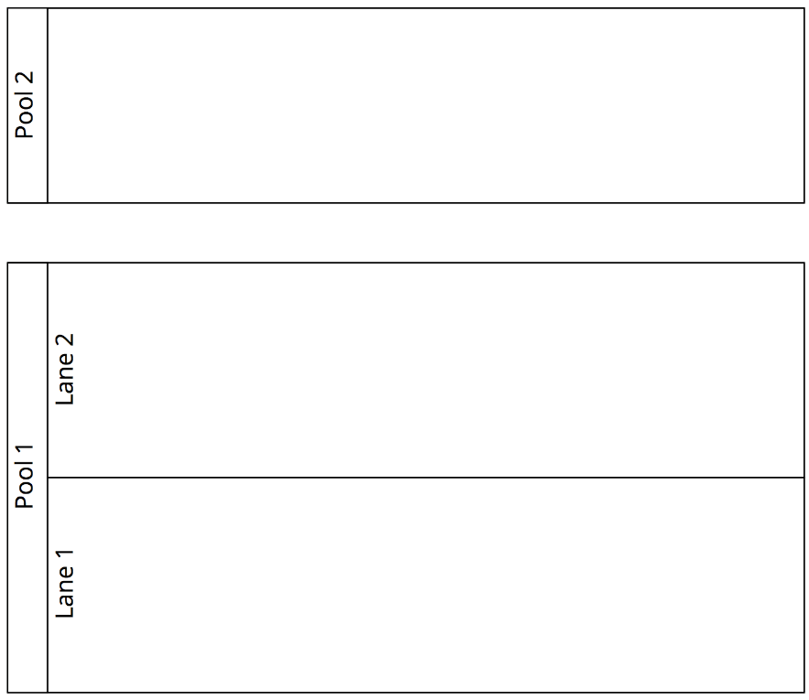

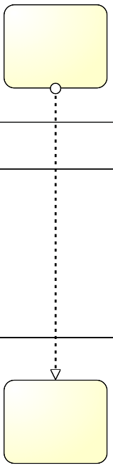
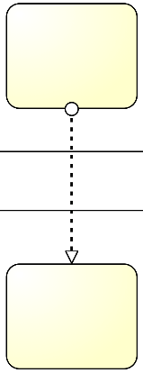


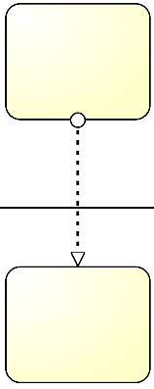
Pools, Lanes and Message Flows: syntax
The Sequence Flow cannot cross the boundaries of a Pool
Both Sequence Flow and Message Flow can cross the boundaries of Lanes
A Message Flow cannot connect two flow elements within the same pool

Slide 63
Black box or white box?

Slide 64
When are messages sent or received?
A Send activity will send the outgoing message upon activity completion
A Receive activity won’t start until the incoming message has been received
Note: the order of the message flows w.r.t. an activity is irrelevant, the above rules always hold

Slide 65
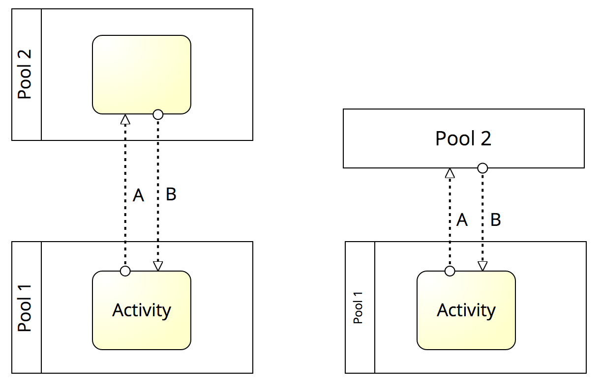
When are messages sent or received?
Message B is first received before Activity can start.
Message A is sent after, upon Activity’s completion
First, message B is received, before Activity can start.
Then, message A is sent, upon Activity’s completion

Slide 66
Process (or Orchestration) Diagram
Models a single business party and can be:
Public view (black box)
Private view (white box)

Slide 67
Collaboration Diagram
Models a global business process between at least two business parties (each modelled by a Pool)
Private process
Public process

Slide 68
Exercise 3.8
Extend the model of Exercise 3.7 by representing the interactions between the loan provider and the applicant.

Slide 69
Chapter 3: Essential Process Modeling
Contents
First Steps with BPMN
Branching and Merging
Business Objects
Resources
Process Decomposition
Process Model Reuse
Recap

Slide 70
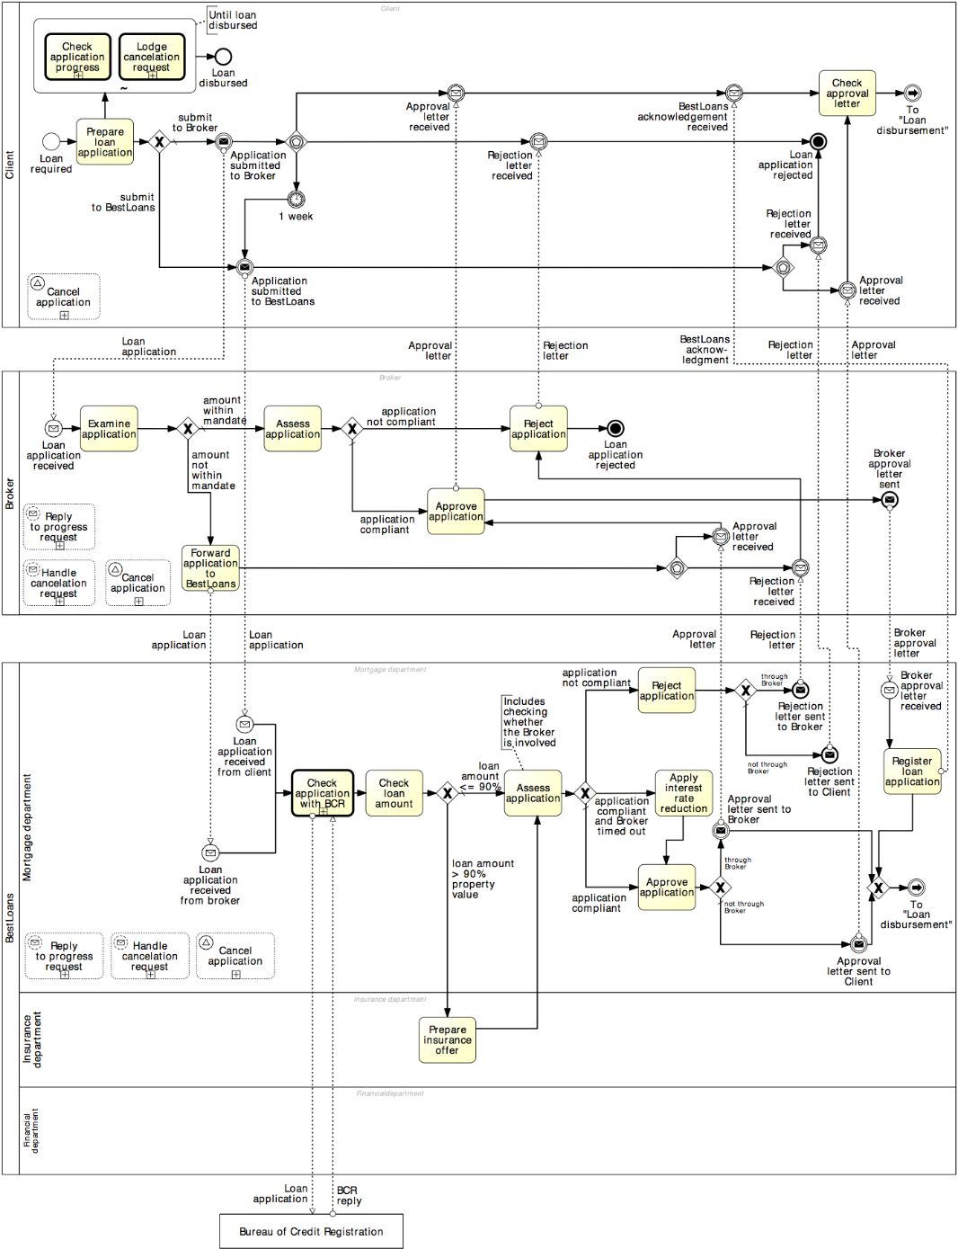
Process decomposition
Notes:
It has been shown that the larger the model, the harder it is to understand it, and the higher is the likelihood of making syntactic mistakes, e.g. creating a deadlock in the model

Slide 71
Process decomposition
An activity in a process can be decomposed into a “sub-process”
Use this feature to:
Improve understanding by breaking down large models
Identify parts that should be:
repeated
executed multiple times in parallel
interrupted, or
compensated
Activities
Notes:
For example, Emit invoice is a task, while Handle shipment is a subprocess as it includes tasks such as pick goods from warehouse shelves, package them, print shipment notice, attach it to package, load into track…

Slide 72
Example: Sub-Process

Slide 73
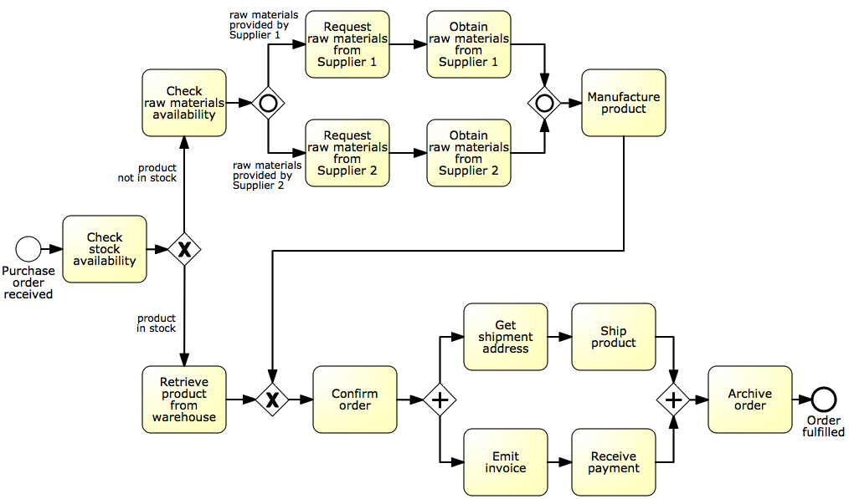
Identify possible sub-processes
Acquire raw materials
Ship and invoice
Notes:
This is a more detailed version of our order-to-cash process where we added a branch to manufacture the product in case it is not in stock, and have made the shipment and invoicing part more detailed by asking for a shipment address and receiving the payment

Slide 74
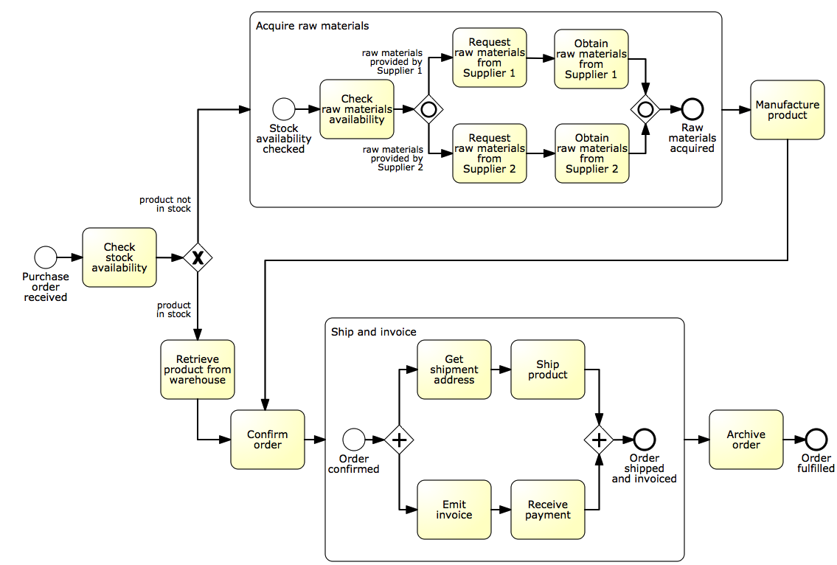
Solution

Slide 75
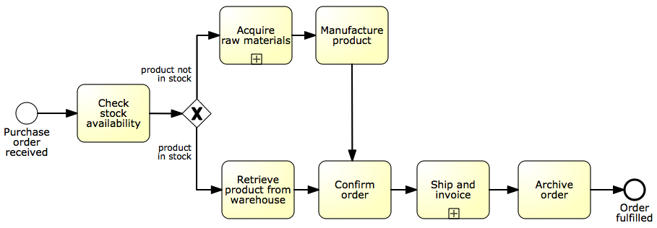
The refactored model
Notes:
From 22 to 10 nodes

Slide 76
Exercise 3.9
Identify suitable sub-processes in the process for assessing loan ap- plications modeled in Exercise 3.6.
Hint. Use the building blocks that you created throughout Exercises 3.1–3.4.

Slide 77
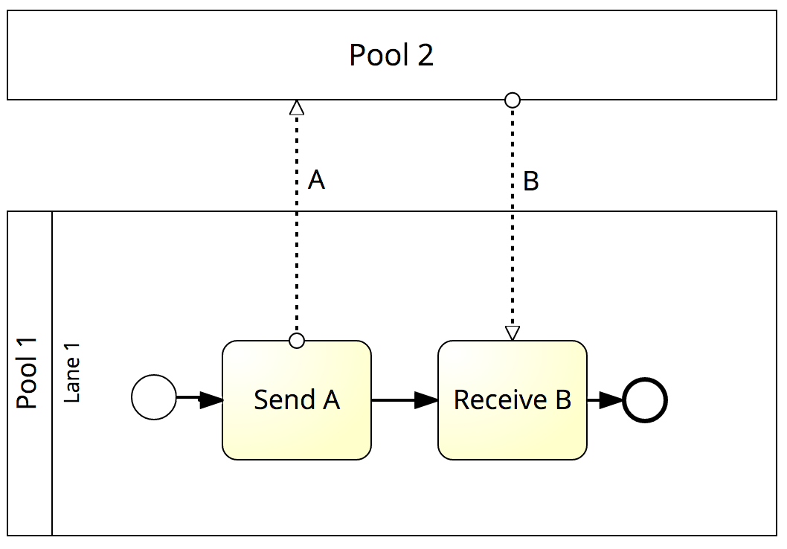
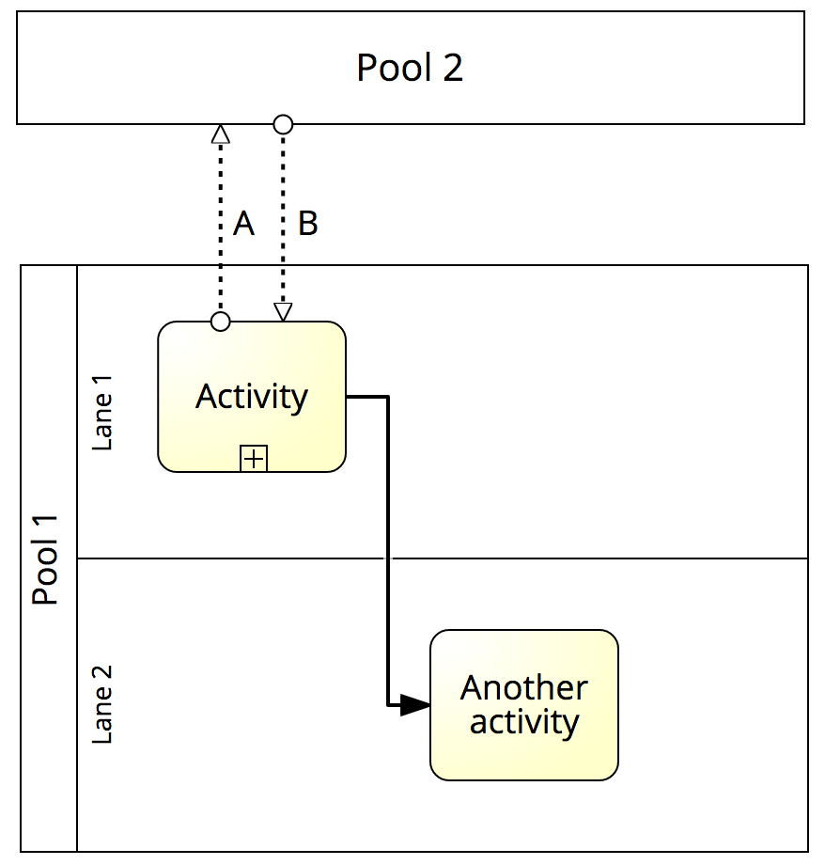
Imposing order of messages via subprocess
The expanded subprocess for “Activity”

Slide 78
Example: Modelling process hierarchies
(Fragment of the SCOR reference model)

Slide 79
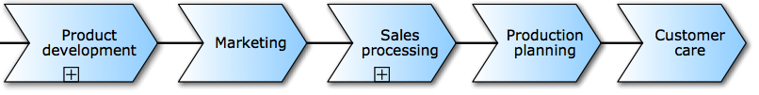
Value chain modelling
Chain of (high-level) processes an organization performs in order to achieve a business goal, e.g. deliver a product or service to the market.
Business
process
“is predecessor of”

Slide 80
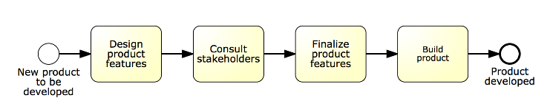
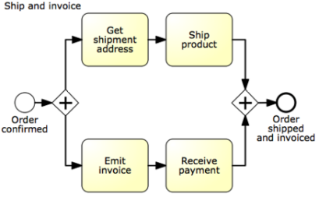
Linking value chains with process models
Process model for this process is available

Slide 81
When should we decompose a process model into sub-processes?

Slide 82
Guidelines: modeling levels
Use sub-processes when the model becomes too large:
Hard to understand
Increased error probability
Level 1 – start with value chain
Level 2 – add main decisions and handoffs (lanes)
Level 3+ – add procedural aspects:
Parallel gateways
Data objects, data stores
Exception handling
And as much detail as is relevant
Decomposition drivers:
Logical: group elements meaningfully (e.g. common business object)
Structural: up to 30 nodes (activities, events, gateways)
Notes:
Relevant: Consider domain, target audience and modelling purpose
Logical: group elements meaningfully on the basis of a common object: everything about invoice (invoice emission subprocess), everything about raw materials (acquisition from suppliers)
Structural: it has been shown empirically that having more than 30 flow objects leads to increased modelling errors

Slide 83
Chapter 3: Essential Process Modeling
Contents
First Steps with BPMN
Branching and Merging
Business Objects
Resources
Process Decomposition
Process Model Reuse
Recap

Slide 84
Embedded or global sub-processes?

Slide 85
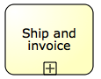
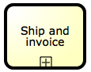
Process Reuse
By default, a sub-process is “embedded” into its parent process (i.e. it is stored within the same file)
In order to maximize reuse, it is possible to “extract” the sub-process and store it as a separate file in the process model repository
Such a sub-process is called “global” model, and is invoked via a “call” activity
(normal)
activity
Call activity
Notes:
(Call activities are represented with a thicker border)

Slide 86
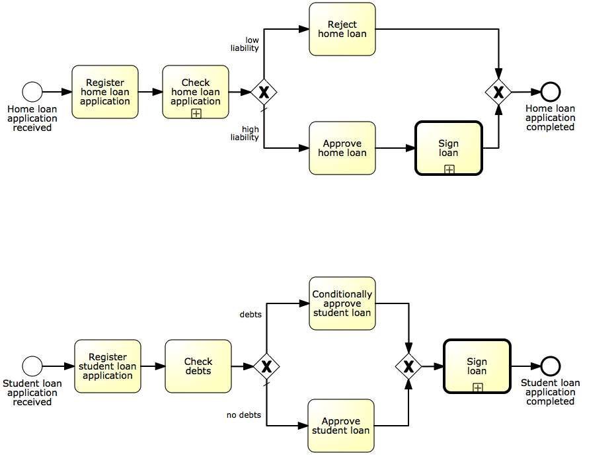
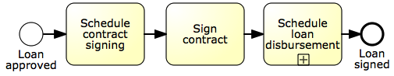
Example: process reuse
Call activity is the default choice to maximize reusability

Slide 87
Exercise 3.9
Identify suitable sub-processes in the process for assessing loan ap- plications modeled in Exercise 3.6.
Hint. Use the building blocks that you created throughout Exercises 3.1–3.4.

Slide 88
Sub-processes: syntax
Sequence flows cannot cross sub-process boundaries
Use start/end events
Message flows can cross sub-process boundaries
To indicate messages emanating from/incoming into the sub-process
Start with at least one start event
If multiple, first occurring will trigger the sub-process
Finish with at least one end event
The sub-process will complete once all tokens have reached an end event. May need an (X)OR-split after sub-process to understand what end event(s) have been reached

Slide 89
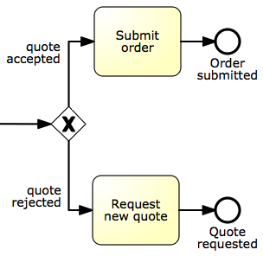
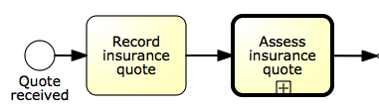
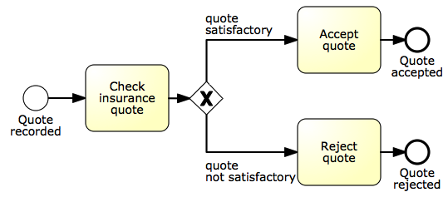
Example: sub-process with multiple end events
Quote-to-order

Slide 90
Exercise 3.10
Identify suitable sub-processes in the process of Exercise 1.7 (page 30). Among these sub-processes, identify those that are specific to this process versus those that can potentially be shared with other processes of the same company.

Slide 91
Chapter 3: Essential Process Modeling
Contents
First Steps with BPMN
Branching and Merging
Business Objects
Resources
Process Decomposition
Process Model Reuse
Recap

Slide 92
Recap
BPMN activities capture units of work in a process
Events define the start and end of a process, and signal something that happens during the execution of it
Gateways model exclusive and inclusive decisions, merges, parallelism and synchronization, and repetition
A process model depicts all the possible ways a given business process can be executed, while a process instance captures one specific process execution out of all possible ones
Data objects capture a physical or digital business object required to execute an activity or trigger an event, or that results from the execution of an activity or an event occurrence
Pools generally model resource classes while lanes are used to partition pools
Sub-processes represent activities that can be broken down in a number of internal steps, as compared to tasks, which capture single units of work

